Slide 1
Effective Heart Disease Prediction Using IBM Auto AI Service
Dr. U. Surya Kameswari, M.Sc., M.Tech., Ph.D.,
Assistant Professor
Department of CSE
Acharya Nagarjuna University
Andhra Pradesh
u.suryakameswari@gmail.com
SI2022IBM00737@smartinternz.com

Slide 2
INTRODUCTION
Human body is made up of various organs, all of which have their own functions. Heart is one such organ which pumps the blood through the body and if it doesn’t to do so, the human body can have fatal circumstances. One of the main reasons of mortality today is having heart disease. So it becomes necessary to make sure that our cardiovascular system or any other system in the human body for that matter must remain healthy. Unfortunately, people all around the world have been facing cardiovascular diseases.
Heart disease also known as cardiovascular disease (CVD). In recent times, heart disease prediction is most complicated task in medical field. In modern era, approximately one person dies per minute due to heart disease. Data science plays a crucial rule in processing huge amount of data in the field of health care. As heart disease prediction is complicate task, there is a need to automate the prediction process to avoid the risks associated with it and alert the patient well in advance.

Slide 3
OBJECTIVES
The main objective of the project is to develop heart disease prediction system using machine learning algorithms. The system can discover and extract hidden knowledge associated with disease from historical heart disease data set.
Reduce the cost of medical tests
Provides new approach to concealed patterns in data.
Helps avoid human biasness.
To implement different classifiers those classifies disease as per input of the user
To evaluate and identify the best out of all algorithms.
Lower number of deaths from heart disease.
Provide disease status to patient before he got infected severely.

Slide 4
LITERATURE SURVEY
Existing Problem:
In the existing system, the input details are obtained from the patient. Then from the user inputs, using ML techniques heart disease is analyzed. Now, the obtained results are compared with the results of existing models within the same domain and found to be improved.
The data of heart disease patients collected is used to discover patterns with NN, DT, Support Vector machines SVM, and Naive Bayes. The results are compared for performance and accuracy with these algorithms.
Proposed Problem:
We develop an AI-based Heart detection system using machine learning techniques. We present data processing that entails working with categorical variables and conversion of categorical columns.
In our proposed system, A predictive model will be built using AutoAI on IBM Cloud Pak for Data. The model is then deployed to the Watson Machine Learning service, where it can be accessed via a REST API. A Node.js web app that allows a user to input some data to be scored against the previous model.

Slide 5
Hardware and Software Requirements
Hardware Requirements:
Processor: Intel® Core ™ i3-3250M CPU @ 2.30GHz
Installed memory (RAM): 8 GB
Operating System: 64 bit
Software Requirements:
IBM Watson Studio
IBM Machine Learning
Python
Node-RED App
IBM Cloud Object Storage

Slide 6
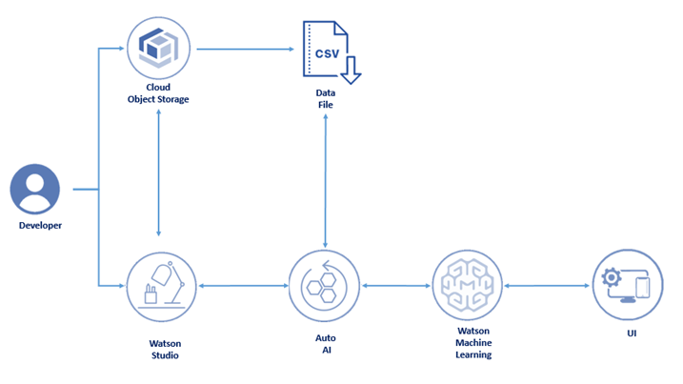
TECHNICAL ARCHITECTURE
The developer creates a Cloud Pak for Data project.
A model is created with AutoAI by uploading some data.
Data is backed up and stored on Cloud Object Storage.
The model is deployed using the Watson Machine Learning service.
A Node.js web app is deployed on IBM Cloud. It calls the predictive model hosted on the Watson Machine Learning service.
A user visits the web app, enters their information, and the predictive model returns a response

Slide 7
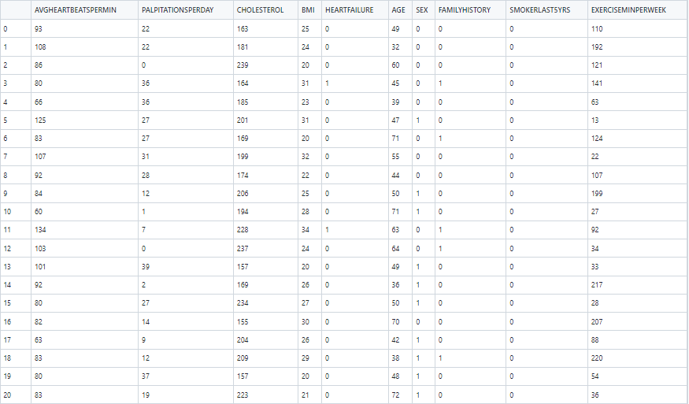
DATA SET

Slide 8
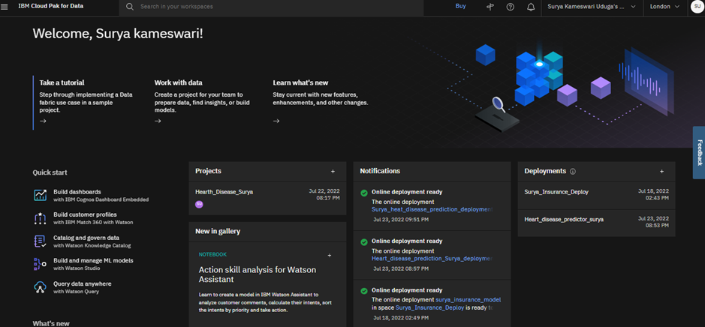
Create a Project

Slide 9
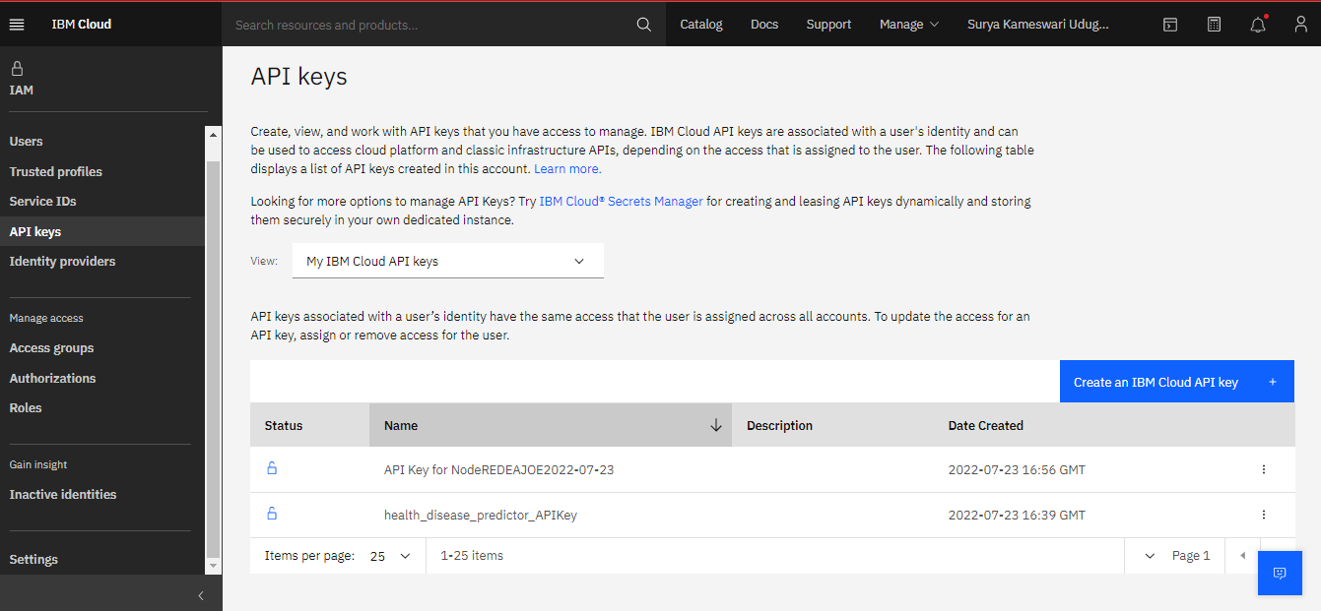
Create an IBM Cloud API key

Slide 10
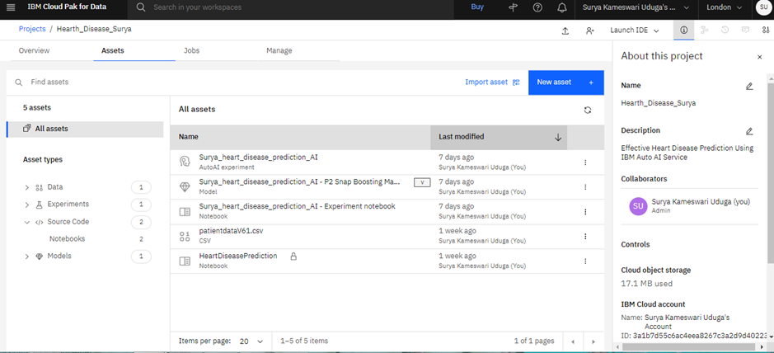
Add Assets to Project

Slide 11
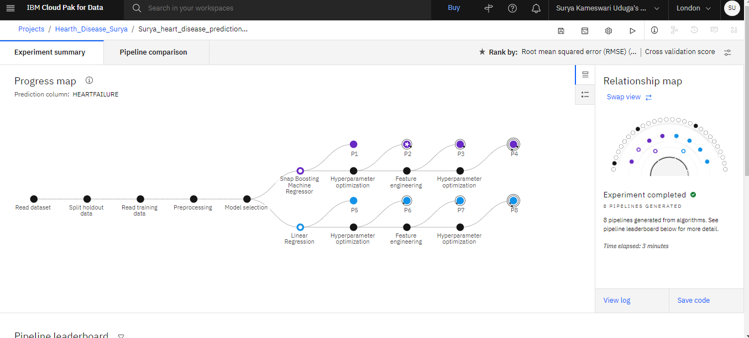
Progress map

Slide 12
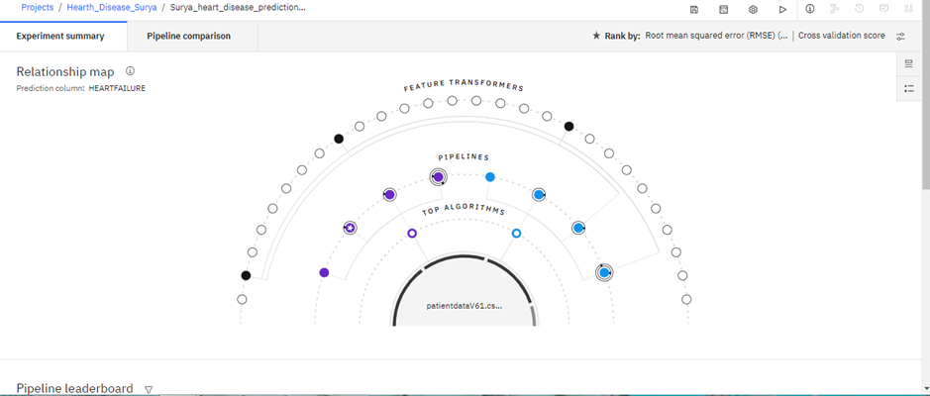
Relationship Map

Slide 13
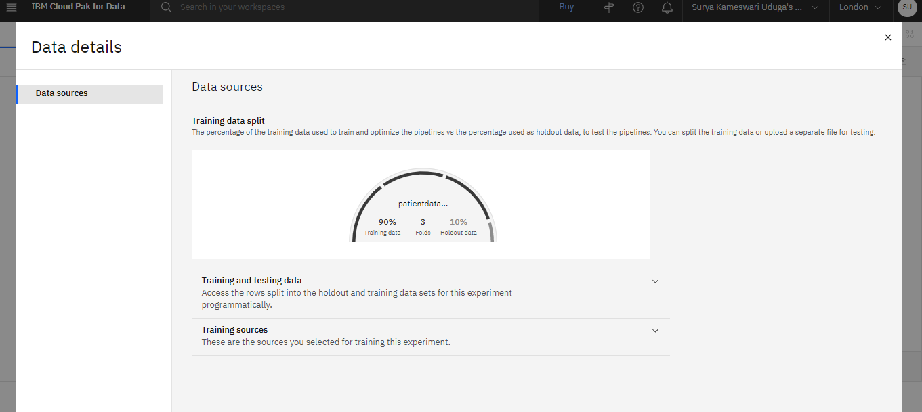
Data Details

Slide 14
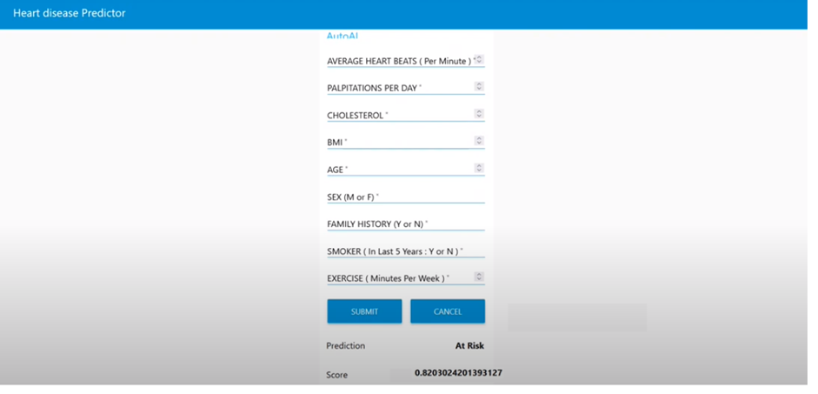
Proposed Model Dashboard

Slide 15


